Slide 1




https://colab.research.google.com/drive/1Jttrrl303F4XnMBlc6TUmW2A9IlJOW2b?usp=sharing
Berk Turhan
Deniz Küçükahmetler
Zeynep Kılınç

Slide 2
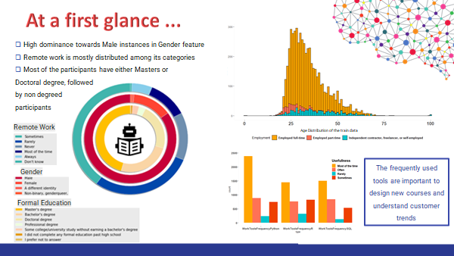


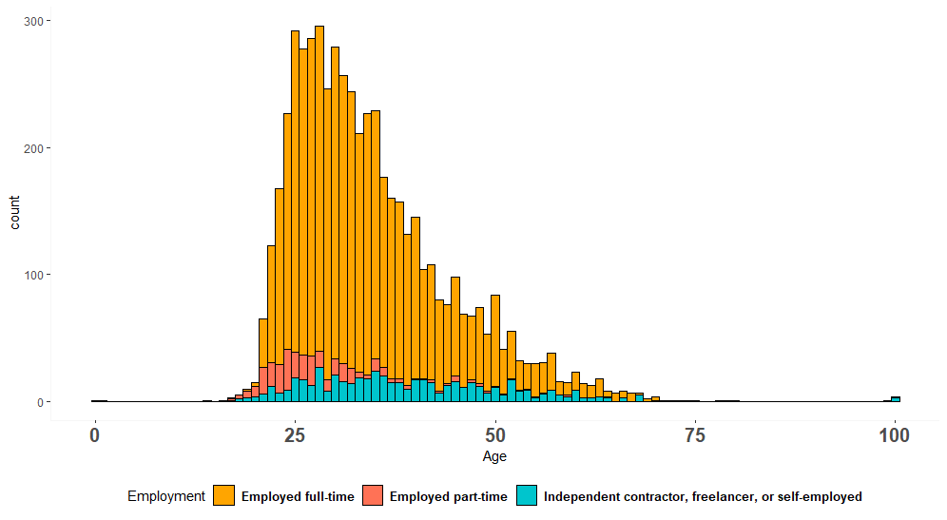
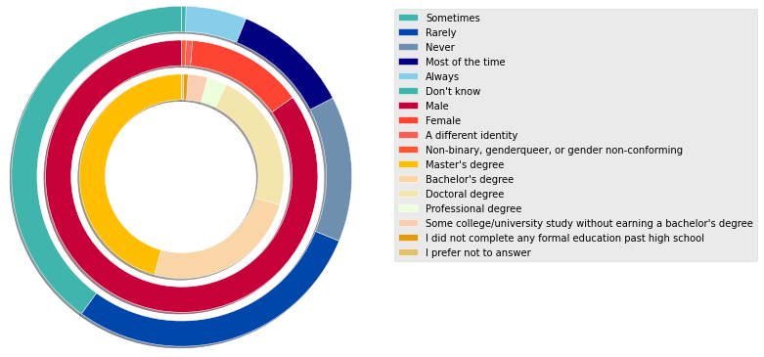

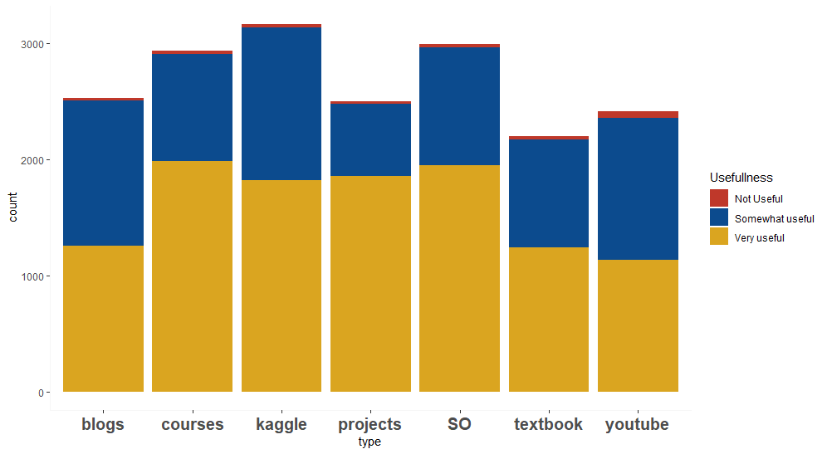

Slide 3
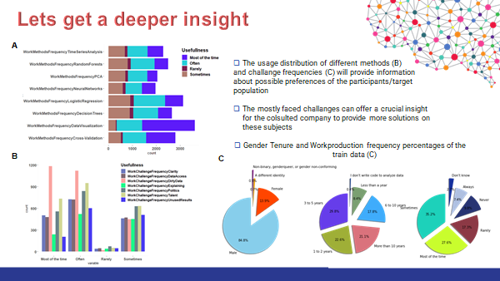
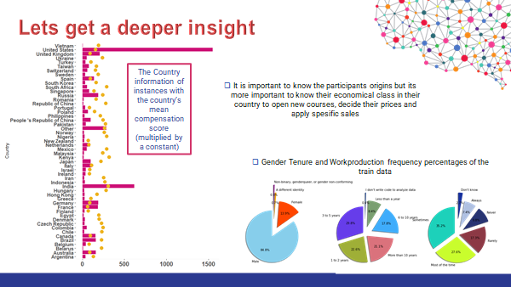
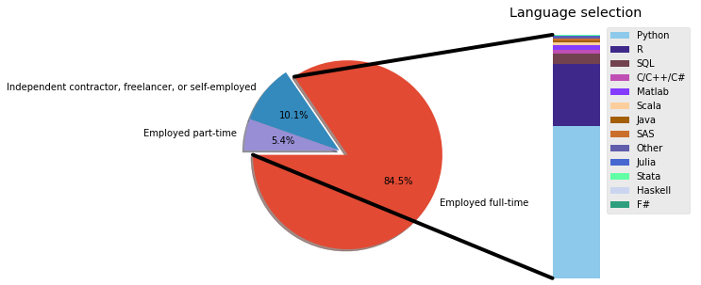
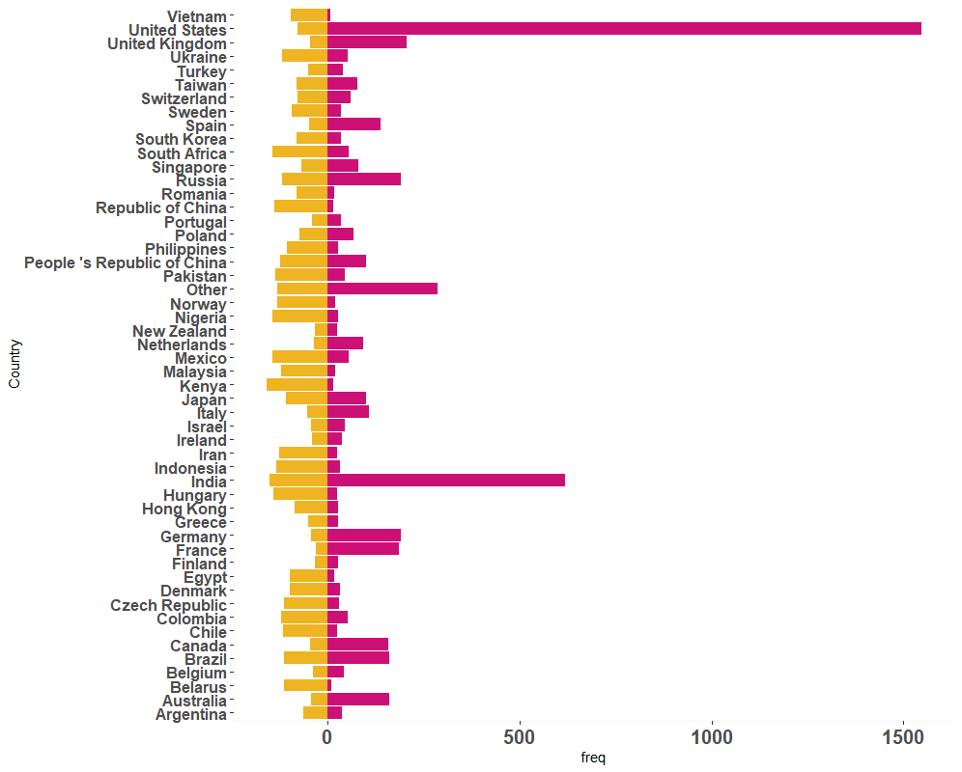

Slide 4

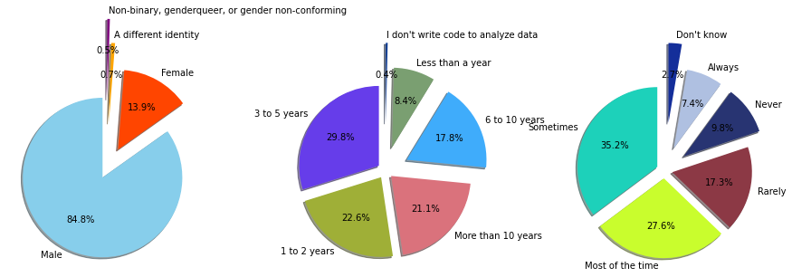
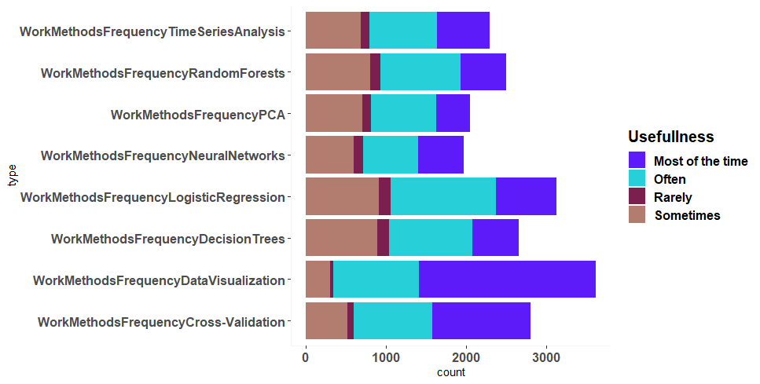

icons

Slide 5
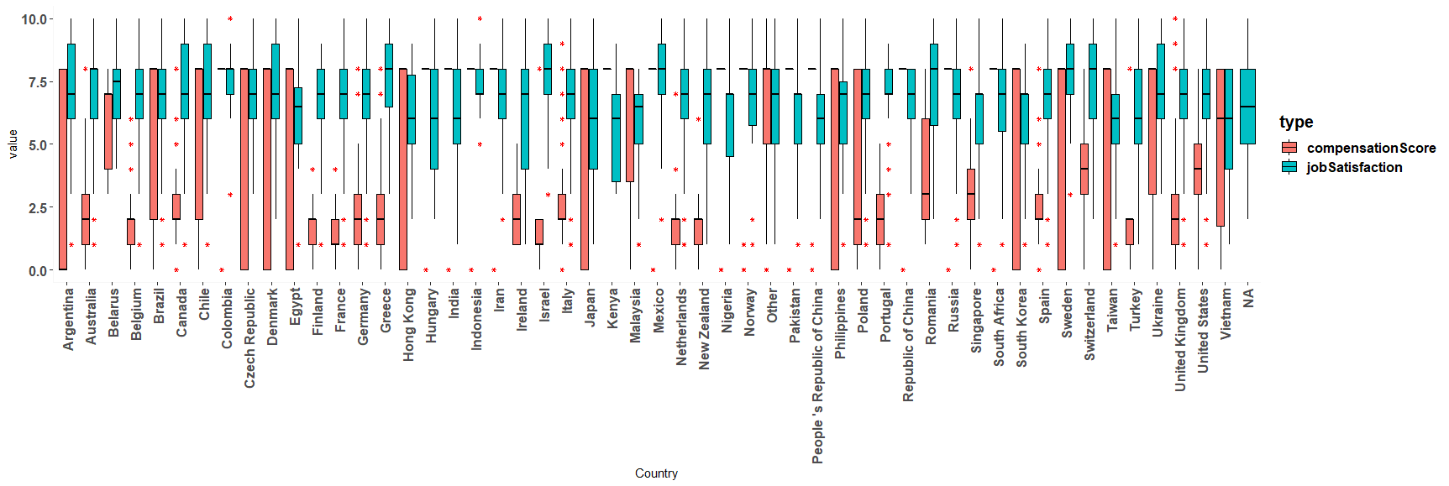

Slide 7
Preprocessing
For preprocessing, several paths were taken:
Dropping rows with NaN values
Filling NaN values with majority voting (for categorical features) and mean values (for numerical features)
Filling categorical features with machine learning based models: SVM and Logistic regression
Trying to drop irrelevant features with domain knowledge and by evaluation with cross-validated RMSE scores in automated combinations if feasible.

Slide 8
Feature Selection/Extraction
Feature Selection is conducted in 2 ways:
Selection of a subset of features according to the possible combinations as a cartesian product.
With checking the unique number of values in each column as well as the NaN numbers, we come up with thresholds to filter the attributes; in order to escape the curse of dimensionality and have minimum edit in the training data in general to keep the data unbiased. As thresholds, we eliminated the features that have either more than roughly 10-11% missing instances or have more than 70 unique values (since we will need one hot encoding in the features). With addition of the domain experience, we selected 15 features which were hypothesized to be most useful. Then, since we were able to reduce the number of features, we were able to iterate through each combination of the features to come up with the best set, where the models would be able to created with the set that gave the minimum RMSE with cross validation and further optimized for hyperparameters.
Generating new features using dimensionality reduction techniques as:
t-SNE : Non-linear relations between features were searched with t-SNE.
Autoencoders: It is used for the compression of features. The compressed part is taken from the ‘bottleneck’ after training the data with the autoencoder network.

Slide 9
Methods
For each method, best hyperparameters are chosen from the parameter space using grid search. The regressors used are given below:
K-NN
Ridge/Lasso Regression and their CV versions
Linear/Polynomial Regression
Neural Networks: Convolutional and Autoencoders
SVM
XGBoost

Slide 10
Results
Model Name | Cross-Validation RMSE cv=10
Linear Regression | 1.99168
K Neighbors Classifier (n=70) | 2.24734
Polynomial Regression (degree=2) | 2.06068
Lasso Regression | 1.98007
Ridge Regression | 1.97679
XGBoost | 1.989766
Autoencoders | 2.010285
t-SNE | 2.004856

Slide 11
Analysis of the system performance
At best, we were able to reduce our cross-validated RMSE metric to 1.97697 with Ridge Regression; where in the Kaggle submission our result best result become 2.00076. We were able to get lower RMSE scores on some random samples populated from the training data. However; with cross-validation, almost all models’ mean RMSE scores were converging in between 1.976 to 2.1. Our feature selection method were taking a long time since it iterates through 2^n different combinations of features where n is the number of the unique features that were initially selected with considering the domain knowledge, missing values and unique number of entries. Even though our system cannot get a lower RMSE than 1.976, we were able to observe consistent results through different models. This may indicate that we can improve our system with more accurate feature selection or preprocessing that can also reduce the time we have spent with the automated iteration through combinations of features while extraction.

